Slide 1
DIWALI
WELCOME TO OUR CELEBRATION OF
THE FESTIVAL OF LIGHTS

Slide 2
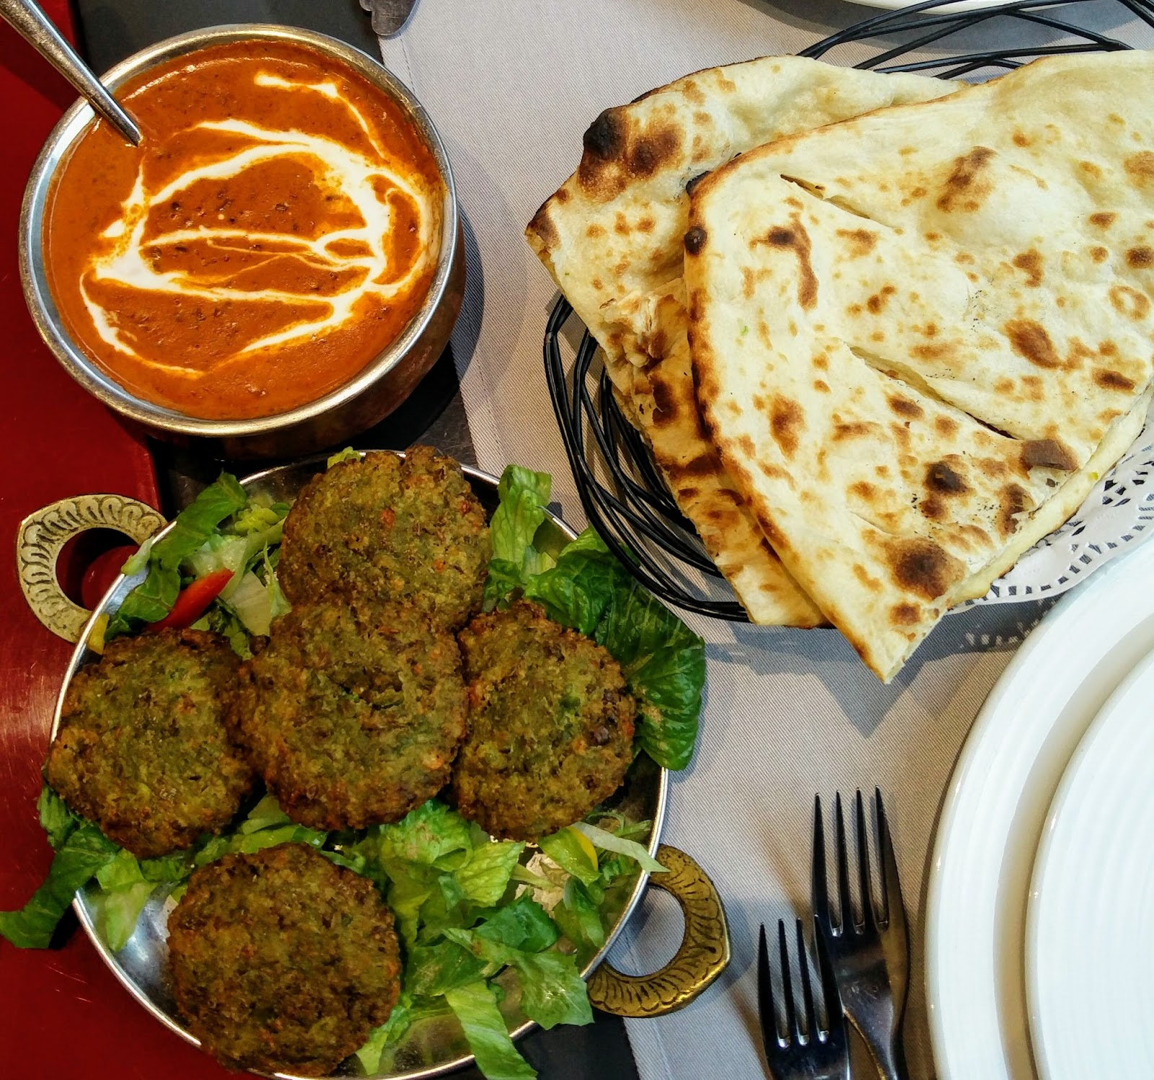
Guess the Dishes through Emojis

Slide 3
Participant team will get 40 seconds to guess the dishes, if not answered question will be passed to the next team
In each round, Team will get 2 chances to guess the correct answer
Each correct answer will get awarded with 5 points to the team to win
Rules

Slide 4





Team A

Slide 5
Answers

Slide 6
Team A
Batata Vada
Bread Pakoda
Bread Omelette
Paani puri

Slide 7



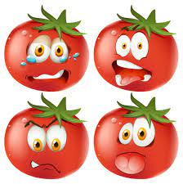

Team B

Slide 8
Answers

Slide 9
Team B
Corn Chaat
Nachos
Kebab
Tomato Soup

Slide 10




Team C

Slide 11
Answers

Slide 12
Team C
Pizza
Dabeli
Upma
Noodles

Slide 13




Team D

Slide 14
Answers

Slide 15
Team D
Dum Aloo
Shahi Paneer
Mutter Pulao
Vada Paao

